Slide 1
Four things to remember
TRUST in God’s plan for your life.
“The Lord has amazing plans for my life” 1Cor. 2:9
SURRENDER to His will for you.
“The Lord is doing something new in my life” Isa. 43:19
BELIEVE in Jesus and His True Presence in the Eucharist
“The Holy Spirit guides me to all truth.” John 16
RECEIVE all He has to gift freely to you.
“The Lord is my shepherd and I lack nothing.” PS 23:1

Slide 2

The Power of the Spirit, Receiving God’s Gift
Life in the Spirit Seminar
Session 3

Slide 3
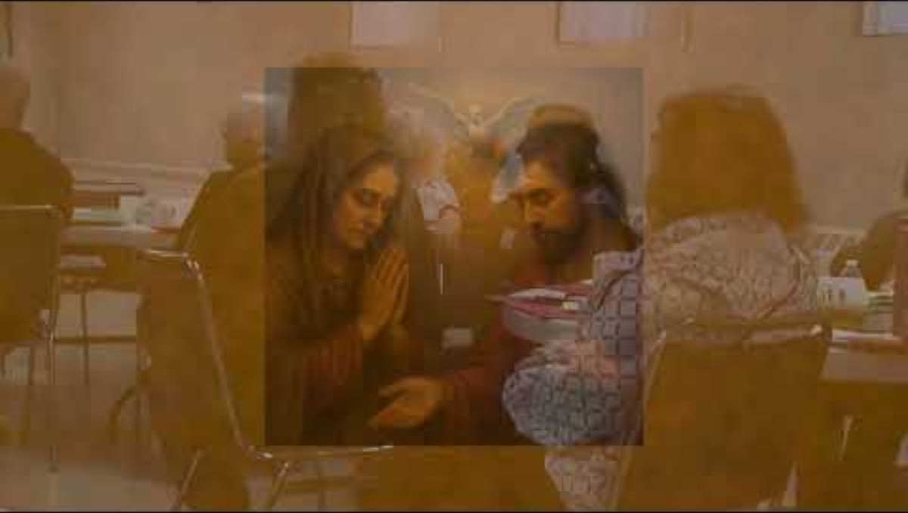
Review of Session 2
https://www.dropbox.com/scl/fi/ebsqwqk2ssbkvsb2nrtqa/Life-in-the-Spirit-Week-2.mov?rlkey=m972v2oqvfq1yeeckgklk4ujo&e=1&st=89ye7xqs&dl=0

Slide 4
Here I am to Worship
Verse 1
Light of the World
You Stepped down into darkness
Opened my eyes, let me see
Beauty that made this heart adore you
Hope of a life spent with you
Refrain
Here I am to Worship
Here I am to bow down
Here I am to say that You’re my God
You’re altogether Lovely
Altogether worthy
Altogether wonderful to me

Slide 5
Verse 2
King of all days
Oh so highly exalted
Glorious in heaven above
Humbly You came to the Earth You created
All for love’s sake became poor
Refrain
Here I am to Worship
Here I am to bow down
Here I am to say that You’re my God
You’re altogether Lovely
Altogether worthy
Altogether wonderful to me
Bridge
And I’ll never know how much it cost
To see my sin upon that cross
I’ll never know how much it cost
To see my sin upon that cross
I’ll never know how much it cost
To see my sin upon that cross
I’ll never know how much it cost
To see my sin upon that cross
Refrain
Here I am to Worship
Here I am to bow down
Here I am to say that You’re my God
You’re altogether Lovely
Altogether worthy
Altogether wonderful to me

Slide 6
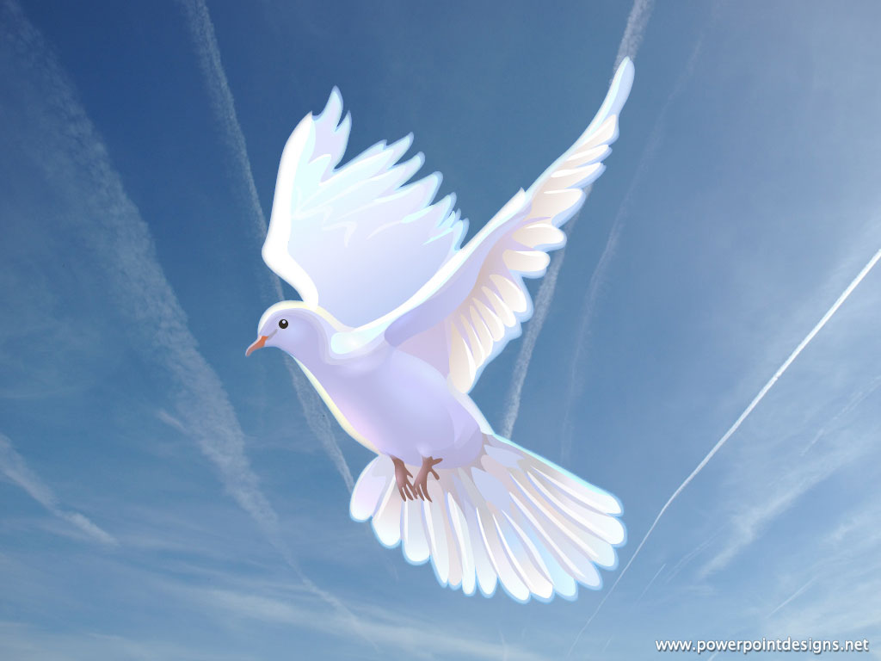
Come, Holy Spirit, fill the hearts of your faithful and kindle in them the fire of your love. Send forth your Spirit and they shall be created. And you shall renew the face of the earth. Let us pray. O God, who by the light of the Holy Spirit, did instruct the hearts of the faithful, grant that by the same Holy Spirit we may be truly wise and ever enjoy His consolations. Through Christ Our Lord. Amen.
This Photo by Unknown Author is licensed under CC BY

Slide 7
The Role of the Holy Spirit
Jesus stresses the importance of the Holy Spirit; His coming would be even more beneficial than Jesus remaining with the Apostles.
The Holy Spirit is the Third Person of the Holy Trinity, equal to God the Father and Jesus His Son.
We receive the Holy Spirit through the sacrament of Baptism.
Through the Sacrament of Confirmation, the work of the Holy Spirit is enhanced so as to have a greater effect as we mature as Christians.
The Gifts of the Spirit are; Wisdom, Understanding, Counsel, Fortitude, Knowledge, Piety, Fear of the Lord. They are Sanctifying Gifts; they serve to enable us to live holier lives.
Every Christian has the Holy Spirit living in their lives as a result of Baptism.
The Spirit works within the individual Christian by empowering him to live as a child of God. The life of the Holy Spirit within us is vitally important to our personal lives and to the effectiveness of the whole Church.

Slide 8
The Power of the Spirit
The Spirit lives in us and desires to transform our lives, the Church and the world.
We may know about the Spirit’s role and power without being open to experience it.
One way in which the Holy Spirit moves is through an experience of New Life in the Spirit as the Apostles experienced at Pentecost.
This New Life in the Spirit can be described as a fresh movement of the Holy Spirit in a person’s life leading to greater growth in personal sanctification and in service for the Church.
This New Life in the Spirit is an experience of the Spirit’s presence and movement in our lives.

Slide 9
Shine Jesus Shine
Verse 1
Lord, the light of your love is shining
In the midst of the darkness, shining
Jesus, Light of the world, shine upon us
Set us free by the truth you now bring us
Shine on me, shine on me
(Refrain)
Shine, Jesus, shine
Fill this land with the Father’s glory
Blaze, Spirit, blaze
Set our hearts on fire
Flow, river, flow
Flood the nations with grace and mercy
Send forth your word
Lord, and let there be light
Verse 2
Lord, I come to your awesome presence
From the shadows into your radiance
By the blood I may enter your brightness
Search me, try me, consume all my darkness
Shine on me, shine on me
Refrain

Slide 10
Verse 3
As we gaze on your kingly brightness
So our faces display your likeness
Ever changing from glory to glory
Mirrored here may our lives tell your story
Shine on me, shine on me
(Refrain)
Shine, Jesus, shine
Fill this land with the Father’s glory
Blaze, Spirit, blaze
Set our hearts on fire
Flow, river, flow
Flood the nations with grace and mercy
Send forth your word
Lord, and let there be light

Slide 11
Experiencing New Life in the Spirit
An overwhelming sense of the presence and love of God.
Being filled with peace or joy
The release of one of the spiritual gifts
Deepens appreciation of the sacraments
Increased desire to spend time in silence and prayer
Reading Scripture becomes more meaningful
The Spiritual gifts are powerful instruments of the work of the Spirit in the Church.
The spiritual gifts include:
Wisdom, Knowledge, Faith, Healing, Miracles, Prophesy, Discernment, Tongues and Interpretation
By yielding to the gifts of the Holy Spirit we begin to experience how the Spirit can use us in a variety of ways.

Slide 12
Opening to the Spirit
While the Holy Spirit is able to transform us, He needs our openness and cooperation.
This requires trust on our part- trusting in the Spirit’s ability to do what we cannot do, to work in ways that do no make sense to our limited understanding.
Obstacles to consider-
Resisting because we do not intellectually understand.
Withholding forgiveness from someone who has hurt us.
Feeling as though we are not worthy or “holy enough.”
Thinking that speaking in tongues or other manifestations are emotional displays, childish or unnecessary. God will not force these manifestations on you. Yielding to these are your decision.

Slide 13
Lead Me Lord
Verse 1
Blessed are the poor in spirit
Longing for their Lord
For God′s coming kingdom shall be theirs
Blessed are the sorrowing
For they shall be consoled
And the meek shall come to rule the world
(Refrain)
Lead me, Lord, lead me, Lord
By the light of truth
To seek and to find the narrow way
Be my way, be my truth
Be my life, my Lord
And lead me, Lord, today

Slide 14
Verse 2
Blessed are the merciful, for mercy shall be theirs
And the pure in heart shall see their God
Blest are they whose hunger only holiness can fill
For I say they shall be satisfied
Refrain
Lead me, Lord, lead me, Lord
By the light of truth
To seek and to find the narrow way
Be my way, be my truth
Be my life, my Lord
And lead me, Lord, today
Verse 3
Blest are they who through their lifetimes sow the seeds of peace;
all will call them children of the Lord.
Blest are you, though persecuted in your holy life,
for in heaven, great is your reward.
Refrain
Lead me, Lord, lead me, Lord
By the light of truth
To seek and to find the narrow way
Be my way, be my truth
Be my life, my Lord
And lead me, Lord, today

Slide 15
Closing Prayer
O Holy Spirit, Breath of the Living God You were breathed into clay to give life to Adam and breathed into the Apostles to give the new life of Christ. Thank you for the life You give to me, the very life of my loving Father.
Holy Spirit, I desire to be made new in every way, I want to fulfill my Father’s plan for my life, and to do my part in renewing the Church and the world.
Yet like a lump of clay, I myself am nothing. I have no strength, no power of my own. I try to change myself and others yet accomplish so little.
Holy Spirit, Your ways are not like my ways. Your thoughts and designs are far different from mine. So often I resist and struggle, yet I realize that it is only by Your ways that the power of God can work.
I abandon myself to Your will for me, to Your ways in my life, to Your gifts at work in me and through me. Breath Your life into me in a new way and make me a new creation for Your honor and glory.
I pray in Jesus’ Name.
Amen

